Slide 1

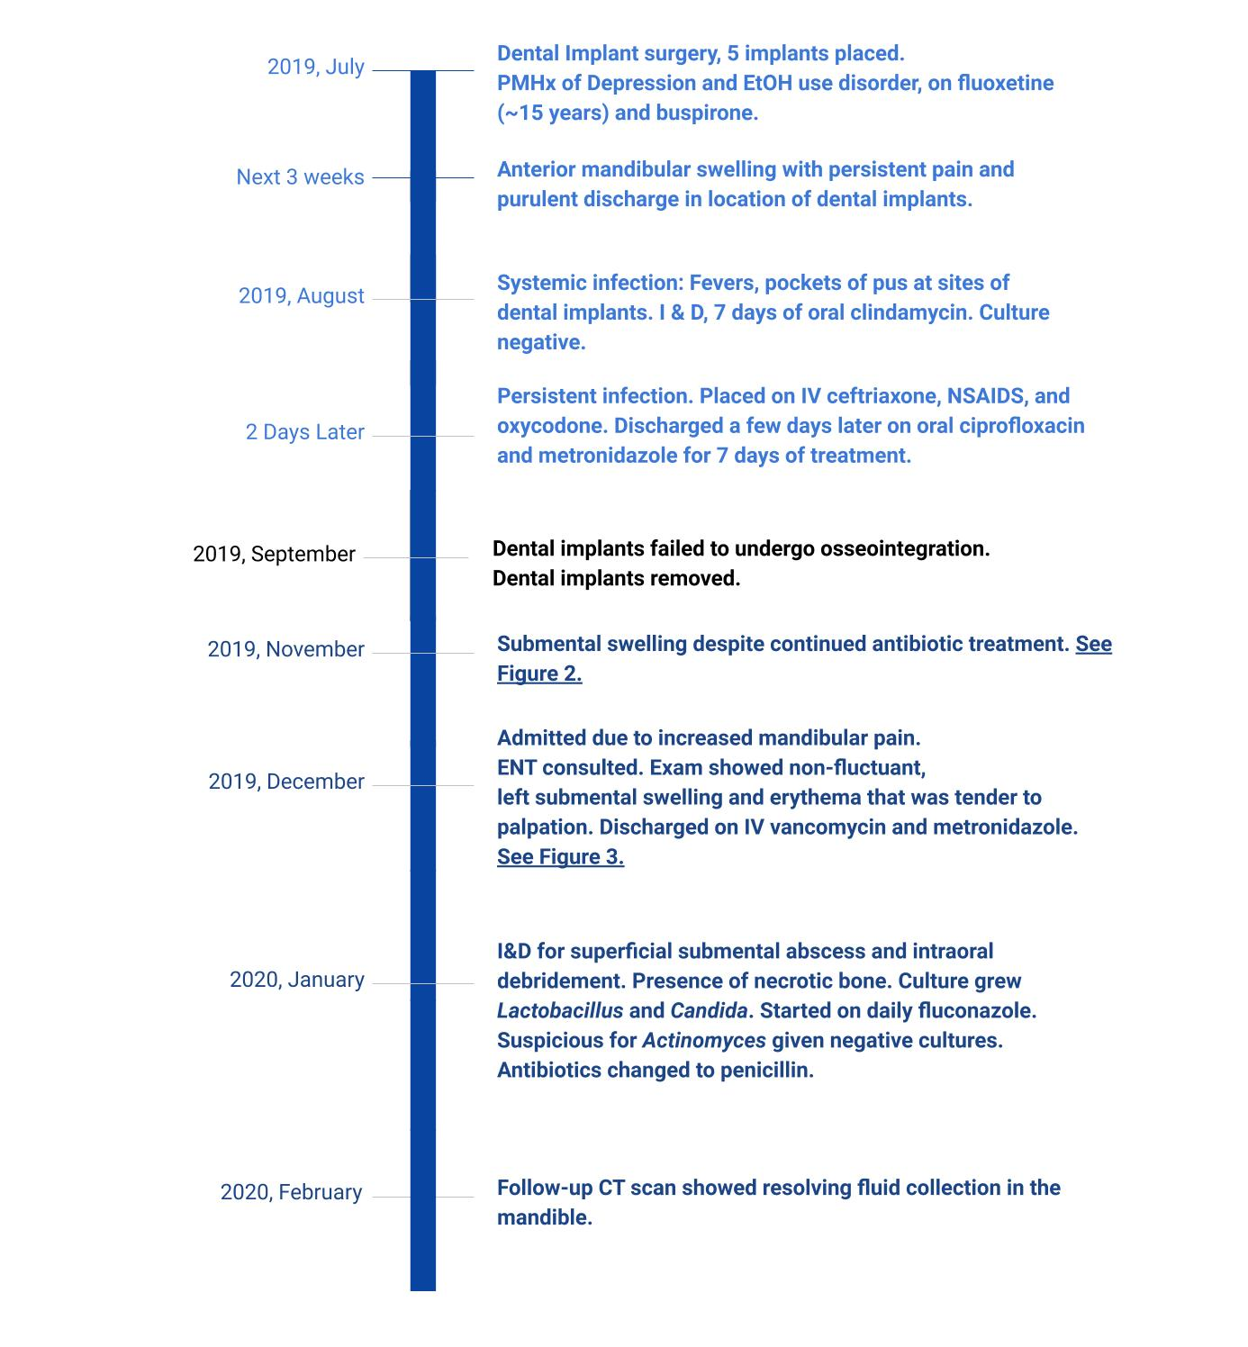
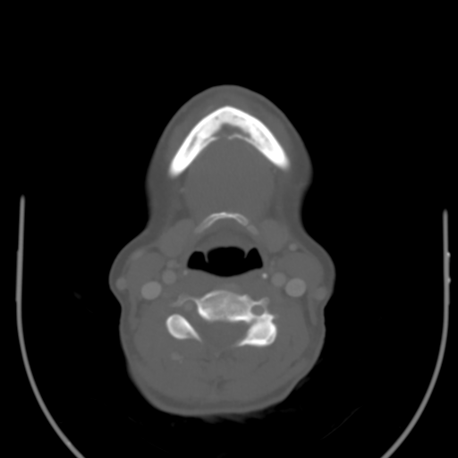
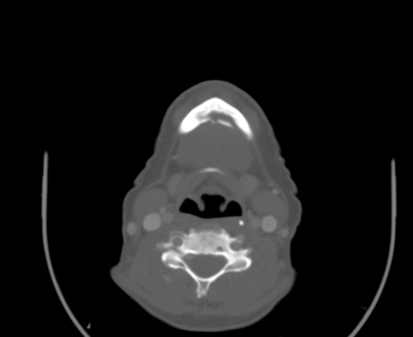
Mandibular Osteomyelitis as a Complication of SSRI-induced Dental Implant Failure - A Systematic Review and Report of a Case
Rahilla Tarfa, PhD¹; Katie Melder, MD²; Leila J. Mady, MD, PhD, MPH²; David Eibling, MD³
¹University of Pittsburgh School of Medicine, Pittsburgh, PA.
²Department of Otolaryngology, University of Pittsburgh Medical Center, Pittsburgh, PA.
³Department of Otolaryngology, Veteran’s Affairs Hospital, Pittsburgh, PA.
Abstract
Results - Systematic Review
Commonly Prescribed SSRIs
Importance: Osteomyelitis of the mandible as a sequalae of dental implant failure is rare. We report a dedicated review of the relationship between selective serotonin reuptake inhibitor (SSRI) utilization and increased risk of dental implant failure.
Objective: To systematically review the relationship between SSRIs and dental implants, including the rare complication of osteomyelitis, with the goal of alerting otolaryngologists to this phenomenon.
Evidence Review: A systematic review of PubMed, Embase and Google Scholar was conducted adhering to the Preferred Reporting Items for Systematic Reviews and Meta-analyses (PRISMA) tools. An electronic search for all records pertaining to SSRIs, dental implants and mandibular osteomyelitis was conducted and included both retrospective studies and case reports.
Findings: Our systematic found only 5 retrospective studies that directly examined the association of SSRIs and dental implants. There was no study or case report that included osteomyelitis as a direct consequence following dental implant failure from SSRIs. However, there were a few case reports on osteomyelitis resulting from failed dental implant osseointegration. SSRIs are associated with increased risk of dental implant failure, and independently, at an even rarer rate, dental implant failure can lead to osteomyelitis.
Conclusions and Relevance: Otolaryngologists should have a low threshold for suspecting osteomyelitis in patients with recent dental implant placement or failure, especially in the context of long-term SSRI utilization. Long-term treatment of chronic osteomyelitis is difficult and severe cases may warrant mandibular reconstructive surgery.
Paper | Study Design | Main Findings
Altay et al. | Retrospective | Study examined 36 SSRI users vs. 596 non-SSRI users. There was an observed failure rate of 5.6% in SSRI users, while among non-SSRI users it was 1.85%. No statistical significance was reached. The odds of osseointegration failure was 3.123 times greater for SSRI users, and they were also 3.005 times to experience early implant failure as compared to non-users.
Carr et al. | Retrospective | 284 (5.2%) of patients started on sertraline prior to dental implants were more likely to have implant failure as compared to patients who were started on a different SSRI (HR, 1.64; 95% CI, 1.07-2.52; p = 0.02) and those with no history of SSRI use (HR, 1.60; 95% CI, 1.15-2.23; p = 0.006). The median duration of sertraline use at the date of implant was 6.9 years (IQR of 2.2 – 11.2 years).
Chrcanovic et al. | Retrospective | The authors found a 12.5% (6/48) implant failure rate for SSRIs and 3.3% (29/883) for non-SSRI users (p-value = 0.006, Fisher’s exact test), with an average loss at 756 days (range = 24 – 3980 days (11.2 years)). Similarly, the Kaplan-Meier analysis showed a statistical difference in the cumulative survival rate between SSRI users and non-users (P < 0.001), with longer survival in the implants placed in non-users as compared to SSRI users. The other two statistical models used, the Multivariate GEE model and multilevel mixed effects parametric survival analysis, demonstrated no significant influence of the intake of SSRIs on implant failure. Furthermore, the GEE model also found no effect of SSRI use on age, sex, implant diameter or bone augmentation. The Multilevel mixed effects demonstrated no statistically significant association between the intake of SSRIs and a higher risk of dental implant failure.
Deepa et al. | Retrospective | This study noted a 10.8% implant failure rate in SSRI users vs. 4.7% in SSRI non-users. Of note, they found a 24% implant failure rate in patients who were greater than 50 years of age and on SSRIs, as compared to 7.4% in patients of the same age group and were not on SSRIs. Patients younger than 50 years of age had an implant failure rate of 7.2% in SSRI users as compared to 3.5% in non-SSRI users.
Wu et al. | Retrospective | SSRIs are associated with a higher risk of dental implant failure, (hazard ratio, 6.28; 95% confidence interval, 1.25-31.61) as compared to non-SSRI users. SSRI usage was defined as filing a prescription for SSRIs at time of implantation. The SSRI non-user group had 440 patients with 35 that had failed implants, while SSRI user-group were 50 patients, with 10 failed implants. The failure rate was 4.6% for non-SSRI users vs. 10.6% for SSRI users. SSRI treatment was associated with an increased risk of implant failure (p=0.03).
Results – Case Report
Introduction
The association between selective serotonin reuptake inhibitor (SSRI) usage and dental implant failure has been documented in the dental literature. This complication can lead to mandibular osteomyelitis. The purview of treatment frequently involves many specialties, including otolaryngology.
As recommended by the 2011 American Psychiatric Association (APA) guidelines, SSRIs are the first-line treatment for depression. Data from the National Health and Nutrition Health Examination Survey (NHNES) shows that 12.7% of people over the age of 12 take antidepressants, with a high utilization rate among females and Caucasians¹. In fact, up to 25% of persons have been on anti-depressant therapy for over a decade, and between 1999 and 2014, there was a 64% increase in its usage. SSRIs are particularly attractive due to their mild adverse-effect profile as compared to earlier generations of anti-depressants.
It has become clear that despite the safe clinical margin of antidepressants, this class of drug can adversely affect bone metabolism². In dental medicine, SSRIs have been associated with adverse effects on dental implant osseointegration and survival. Moreover, dental implants have been associated with the rare complication of osteomyelitis^{3,4}. This raises a point of concern for otolaryngologists who care for the head and neck cancer population, a group among which a pre-cancer diagnosis of depression is associated with a 1.49 times greater hazard ratio of cancer-specific mortality⁵. We conducted a systematic review of the literature to ascertain the association between SSRIs and dental implant failure and present a rare case of osteomyelitis following SSRI-induced dental implant failure.
CT Neck with Contrast, at level of mandible
Methods and Materials
Figure 2. Initial Presentation (11/2019), A. Axial view, bone window and B. Axial view, soft tissue window showing abnormal lucency in the mental process of mandible (*)
*
*
The systematic review examined the relationship between SSRI usage and dental implant failure, as well as resultant osteomyelitis. The Preferred Reporting Items for Systematic Reviews and Meta-analyses (PRISMA) reporting guideline was followed. Electronic searches were conducted by the authors using PubMed, Embase and Google Scholar databases, using the search terms: “SSRIs AND Dental Implants”, “SSRIs AND Osteomyelitis” and “SSRIs, dental implants AND Osteomyelitis”. Additional individual papers were also found via isolated google searches.
2 reviewers independently screened both titles and abstracts excluding studies that did not focus on investigating the relationship between SSRI utilization and dental implant failure. Studies that did not focus on chronic mandibular osteomyelitis after dental implants failure were also excluded. Both retrospective studies and case reports were included, while systematic reviews were excluded. Figure 1 shows the selection process for reviewed studies.
A
B
Conclusions
Overall, given the complicated clinical course that patients with osteomyelitis following failed dental implant osseointegration can present with, early and aggressive treatment should be pursued. Moreover, otolaryngologists should be acutely aware of the associated risk of SSRIs with mandibular osteomyelitis, as they are uniquely poised to evaluate and treat these patient populations.
Figure 3. Follow up (12/2019), A. Axial view, bone window with worsening lucency (*) and B. Sagittal view, soft tissue window with developing submental fluid collection
*
Records identified through database searching
(n = 88)
Additional records identified through other sources
(n = 0)
Bibliography
Identification
A
**
1. Pratt L, Brody D, Gu Q. Antidepressant Use Among Persons Aged 12 and Over: United States, 2011-2014. Published August 2017. Accessed March 15, 2020. https://www.cdc.gov/nchs/data/databriefs/db283.pdf
2. Sansone RA, Sansone LA. SSRIs: Bad to the Bone? Innov Clin Neurosci. 2012;9(7-8):42-47.
3. Semel G, Wolff A, Shilo D, Akrish S, Emodi O, Rachmiel A. Mandibular osteomyelitis associated with dental implants. A case series. Eur J Oral Implantol. 2016;9(4):435-442.
4. Schlund M, Raoul G, Ferri J, Nicot R. Mandibular Osteomyelitis Following Implant Placement. J Oral Maxillofac Surg. 2017;75(12):2560.e1-2560.e7. doi:10.1016/j.joms.2017.07.169
Records after duplicates removed
(n = 70)
B
00
Screening
Records screened
(n = 53)
Records excluded
(n = 41)
Eligibility
Full-text articles assessed for eligibility
(n = 10)
Full-text articles excluded, with reasons
(n = 5)
Figure 4. Most recent (2/2020), A. Axial view, bone window with stable lucency (*) and B. Sagittal view, soft tissue window with improved fluid collection (**)
*
Contact
Included
Studies included in qualitative synthesis
(n = 5)
Dr. David E. Eibling, MD
Department of Otolaryngology
University of Pittsburgh Medical Center
Veterans Affairs
eiblingde@upmc.edu
A
B
**
Figure 1. Selection of studies for chart review on SSRIs and the effect on dental implants.

